Slide 1

Rate and Review Prediction
Mahaboob Basha Shaik

Slide 2
Problem Statement
We have a client who has a website where people write different reviews for technical products. Now they are adding a new feature to their website i.e. The reviewer will have to add stars(rating) as well with the review. The rating is out 5 stars, and it only has 5 options available 1 star, 2 stars, 3 stars, 4 stars, 5 stars. Now they want to predict ratings for the reviews which were written in the past and they don’t have a rating. So, we have to build an application which can predict the rating by seeing the review.

Slide 3
Understanding
For Rating Prediction projects one need to understand about various libraries NLTK, Tokenization and many other models building techniques.
Prediction based on the categorical data is quite challenging as we can face issue with overfitting and underfitting.
Working knowledge on Web scraping would help in fetching of right data.

Slide 4
EDA
Mathematical/ Analytical Modelling of the Problem
Pandas: The Python Data Analysis Library is used for storing the data in data frames and manipulation.
NumPy: Python scientific computing library.
Matplotlib: Python plotting library.
Seaborn: Statistical data visualization based on matplotlib.
NLTK: Neural Networking Libraries.
Tokenization: Systematic breaking of senstences
SciPy. Stats: Provides a number of probability distributions and statistical functions.

Slide 5
EDA
Data exploration is the first step in data analysis and typically involves summarizing the main characteristics of a data set, including its size, accuracy, initial patterns in the data and other attributes. It is commonly conducted by data analysts using visual analytics tools, but it can also be done in more advanced statistical software, Python. Before it can conduct analysis on data collected by multiple data sources and stored in data warehouses, an organization must know how many cases are in a data set, what variables are included, how many missing values there are and what general hypotheses the data is likely to support.
The cleaning module removes the noise, and check that all the values are not empty, otherwise the item is dropped. This is done for simplicity; indeed, it could be better to try to inference them later. After the cleaning part done, the item is sent to the formatting module.

Slide 6
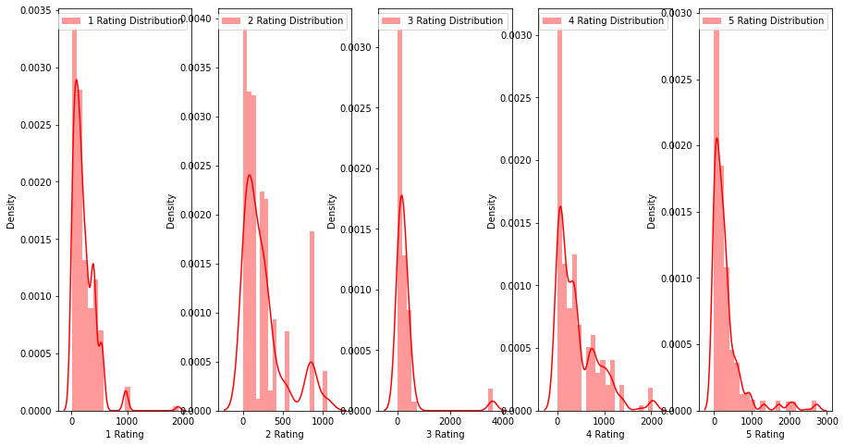
Visualisation – Univariant Analysis

Slide 7

Steps and Assumptions
Drop Unnecessary Columns
Modelling data
Using NLTK Libraries
Vectorising the Words for model building
Assumptions:
Add Product Name and Model in the data could bring more accuracy.
This a generalised prediction can’t be considered specifically.

Slide 8
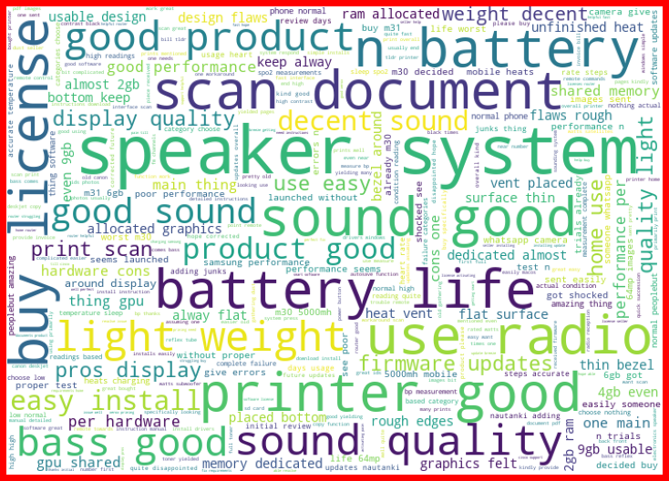
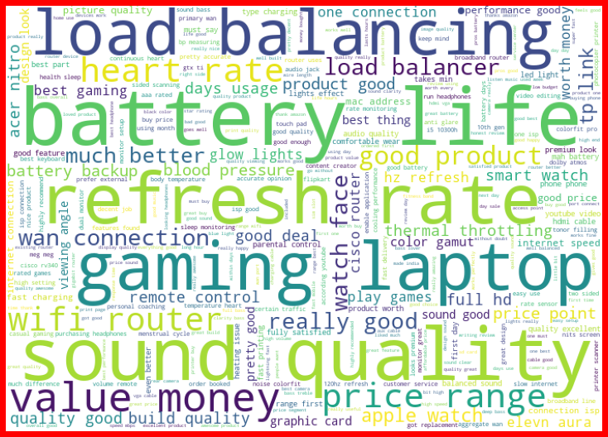
Word Cloud
Word cloud helps in understanding the top set of words which are impacting the study in a meaningful way.

Slide 9
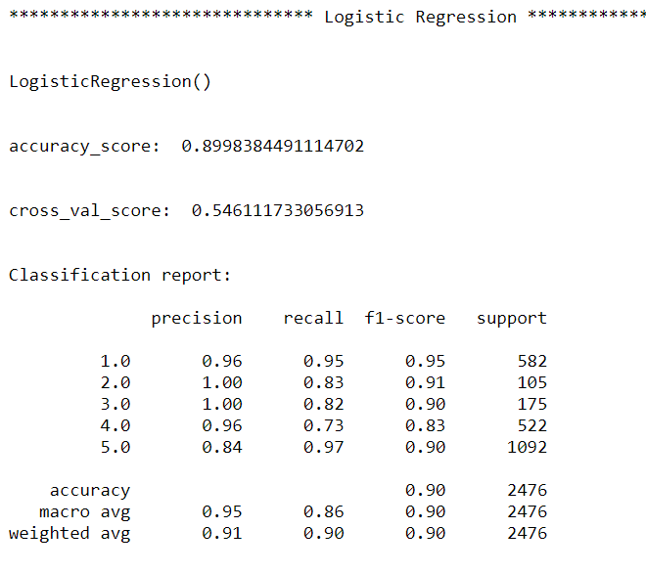
Logistic Regression

Slide 10
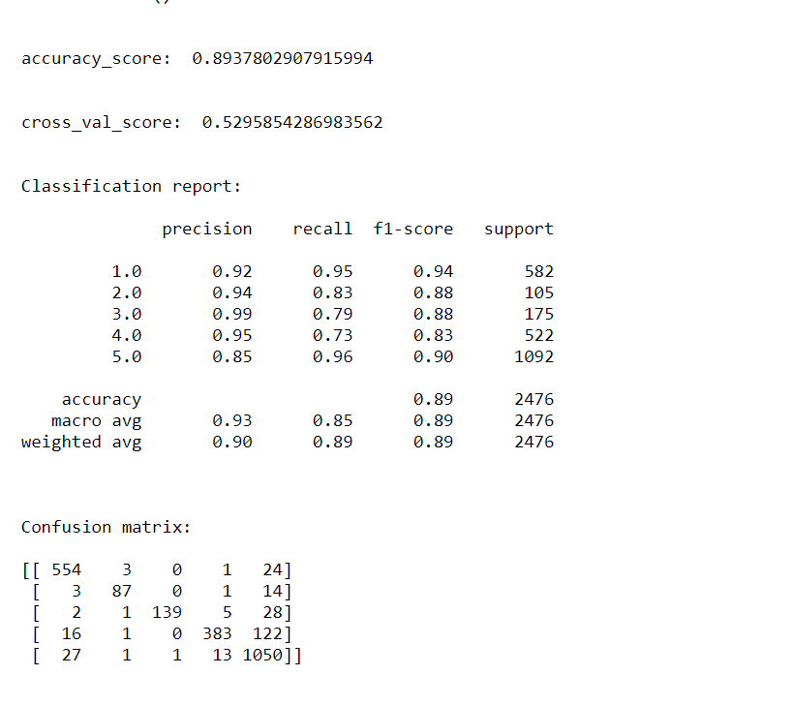
MultinomialNB

Slide 11
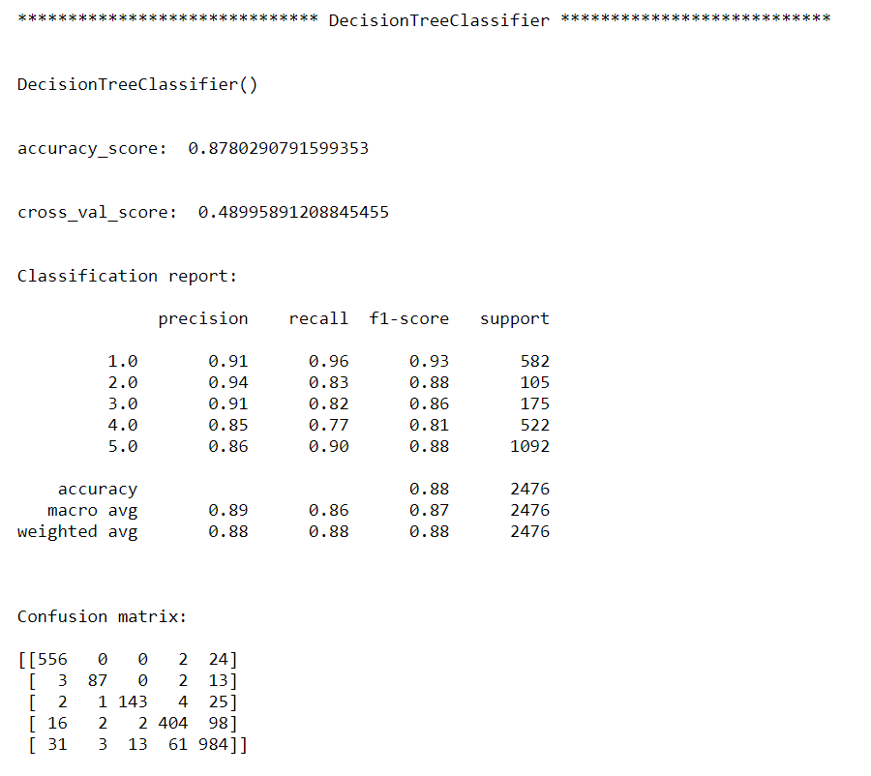
Decision Tree

Slide 12
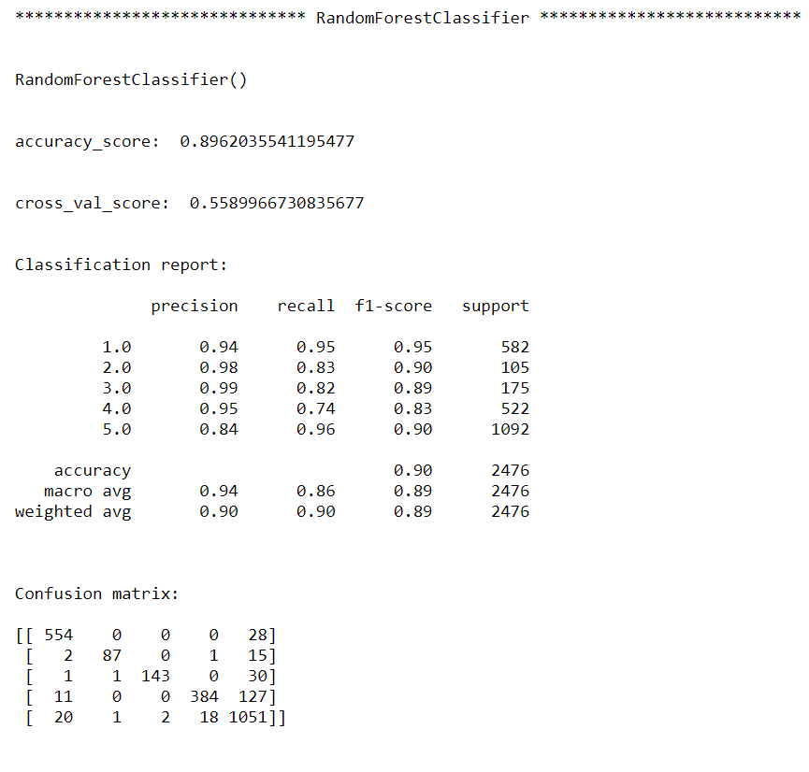
Random Forest

Slide 13
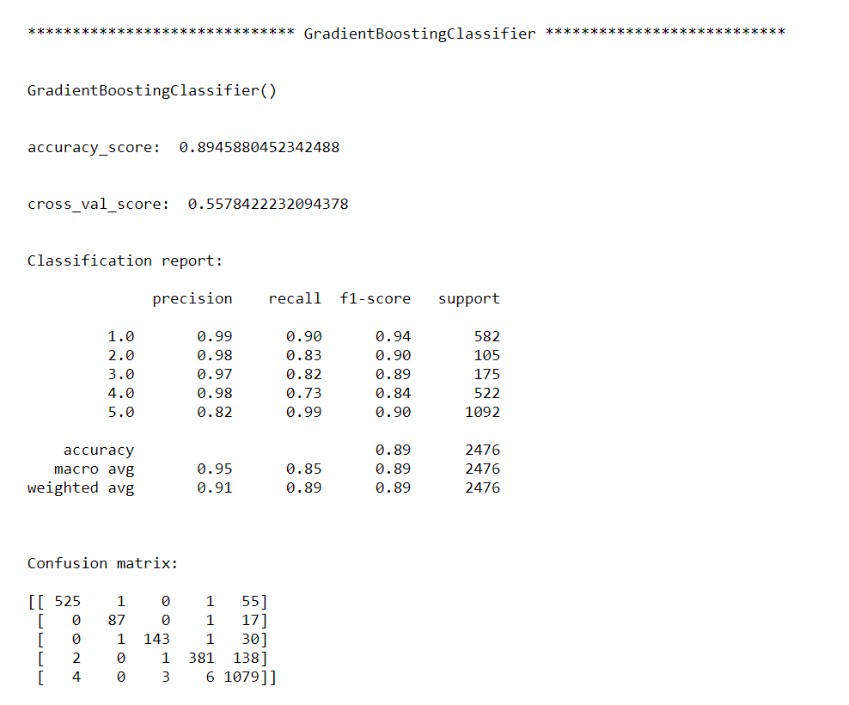
Gradient Regressor – Finalised Model

Slide 14
Conclusion
The study shows a comparison between the regression algorithms and artificial neural network when predicting reviews.
The local data gave a worse outcome when the same pre-processing strategy was implemented due to it being in a different shape compared with the public data in terms of the number of features and the correlation strength.
Hence, the Online data needs more features to be added preferably with a strong correlation with the Rating.
However, Logistic Regression got the best R2 score overall. The final results of this study showed that Logistic Regression better prediction compared to other used algorithms.

Slide 15

Thank You

